Slide 1
Red Agents IT Help Desk Sprint #5 Review
Anna Vadella, Kwesi Kyei-fordjour, Daniel Field, Garret Blake, Elijah Heslop

Slide 2
Goals for Sprint
Implement all functionalities surrounding reopening tickets - 4
Ensure all emails “types” are being sent when necessary - 2
Implement PDFs into forms + ideally include downloadable links for each PDF - 5
Make report generation process automated - 3
Implement “Forgot Password” Functionality - 2

Slide 3
Updates
Implementation of reopen ticket functionalities
Automated report generation and created new generated report form
Implementation of forgot password functionality
Finished all email templates and formatting
Figured out a “work around” for how to implement our PDF documents into our forms

Slide 4
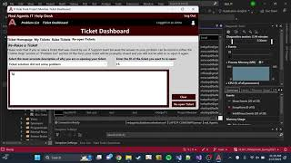
GUI Video Demo
https://youtu.be/hLcn5zmJtFM

Slide 5
Sprint Challenges
Figuring out how to implement reopened tickets
Figuring out how to implement our PDFs
Forms are framework instead of net framework, created a huge dilemma
Kwesi’s laptop is still kind of broken
Issues with email implementation

Slide 6
Finishing Touches
Adding more questions to the PDFs and then re-added the updated PDFs to the form
Refresh buttons
Enter button functionality
Possibly change structure of IT Support Team form

Slide 7
Any Questions?

